Slide 1

Status Report: Project name
AMBULANE

Slide 2

PROJECT INSIGHT
SCHOOL NAME: National Public School Koramangala
PROJECT NAME: AMBULANE
PROJECT STATEMENT: An app to reduce Ambulance Response Time through early notification.
TEAM MEMBERS: Rajdeep Nag, Aniket Sanghi, Rajat Agarwal, Ayush Agrawal, Kaustubh Roy, Aditya Naidu

Slide 3
WHAT
IS
AMBULANE?
AMBULANE is a public service app designed to effectively reduce the inconveniences faced by ambulances on Indian roads, thus potentially saving lives.

Slide 4
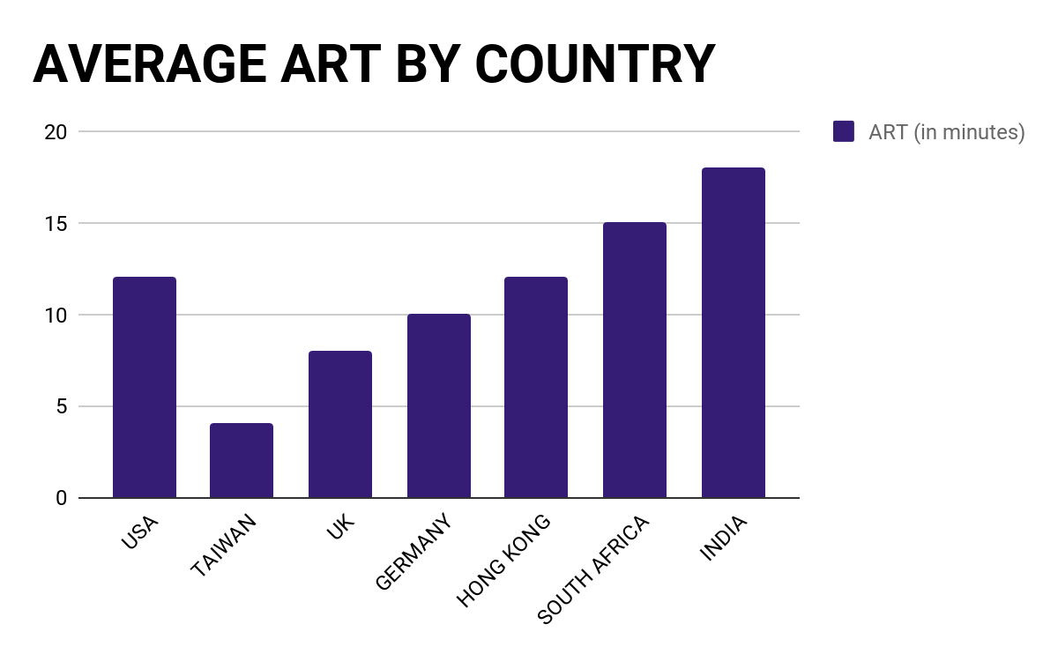

Slide 5

OUR SOLUTION
Step 1
Step 2
Step 3
The ambulance and the client upload their location in the database
The data is processed at the server end and a list of clients to which the notifications are to be sent is prepared
The application then returns a variable to the APK. If true, a corresponding notification is created and sent to the user

Slide 6
DEMO

Slide 7
LEARNING, BENEFITS AND VALUE ADDITION
TEAMWORK – Learnt to effectively plan with a team
PROJECT ORGANIZATION – Learnt the sequential steps in the process of development
INDUSTRY WORKING – Worked with Cisco mentors who work hands-on in the IT industry
PROBLEM SOLVING – Brainstorming solutions to a community level problem
CRISIS MANAGEMENT – Program error crisis situation management during demos.

Slide 8

THANK YOU

